Slide 1

ProTune
Made by Kristers Jirgensons, Kristers Bizuns, Jānis Petrovs

Slide 2
Purpose of website
To promote ProTune's chiptuning services and educate potential clients about vehicle performance optimization.

Slide 3
Target audience
Car enthusiasts looking to enhance their vehicle's performance through software optimization.
Vehicle owners seeking better fuel efficiency or more horsepower.
Automotive professionals who may partner with or refer clients to ProTune.

Slide 4
Goals
Deliver
Deliver a professional online presence for ProTune.
Enable
Enable smooth interaction between users and the service team.
Lay
Lay the groundwork for future expansion, like payment integration or user-specific tuning recommendations.

Slide 5
Website structure

Slide 6
Frontend
Index.html – Which is the main landing page with navigation to Homt, Tuning, About us and Contact us
Admin – To allow the Administator to run CRUD operations

Slide 7
Backend
Through PhP and JS - handles login, registration, admin panel, chip data retrieval, contact form

Slide 8
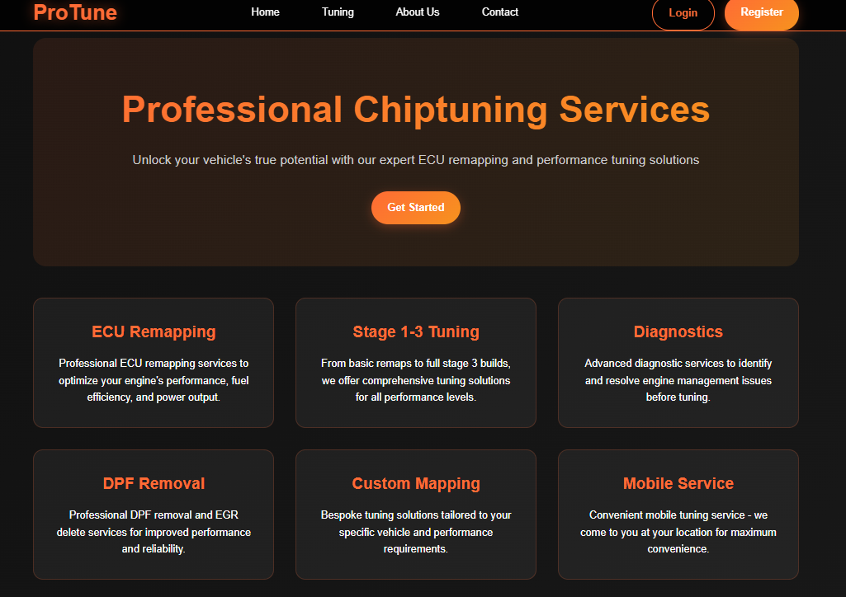

Slide 9
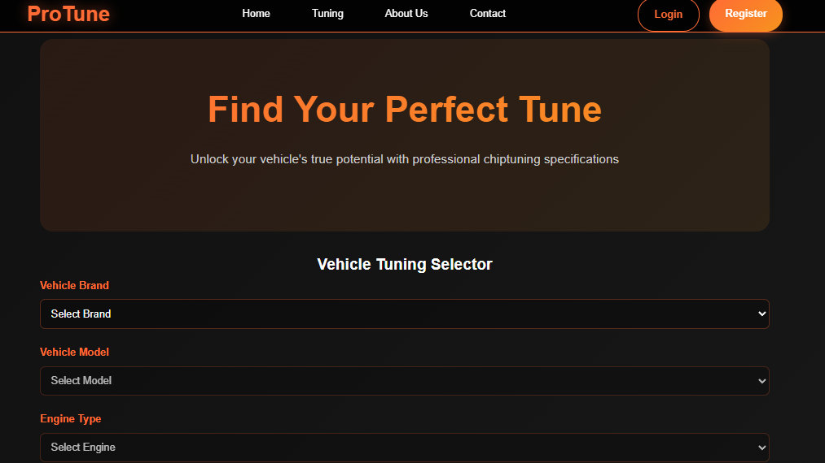

Slide 10
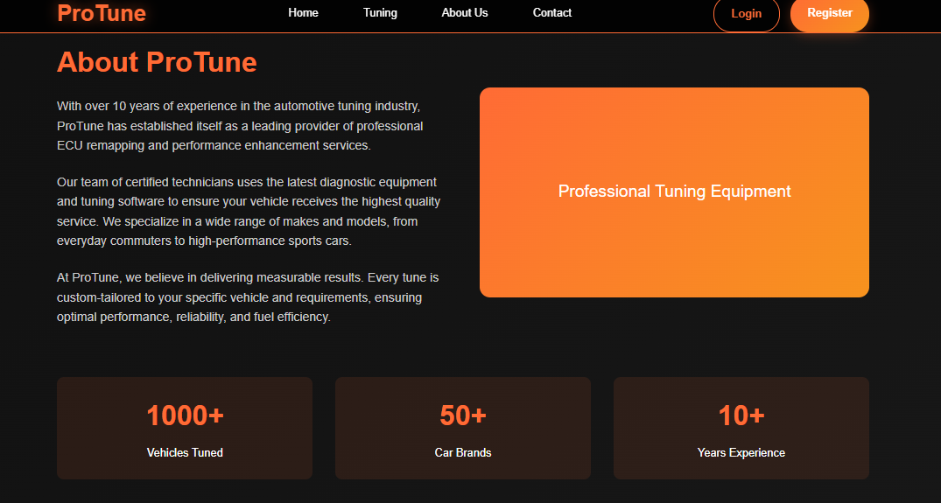

Slide 11
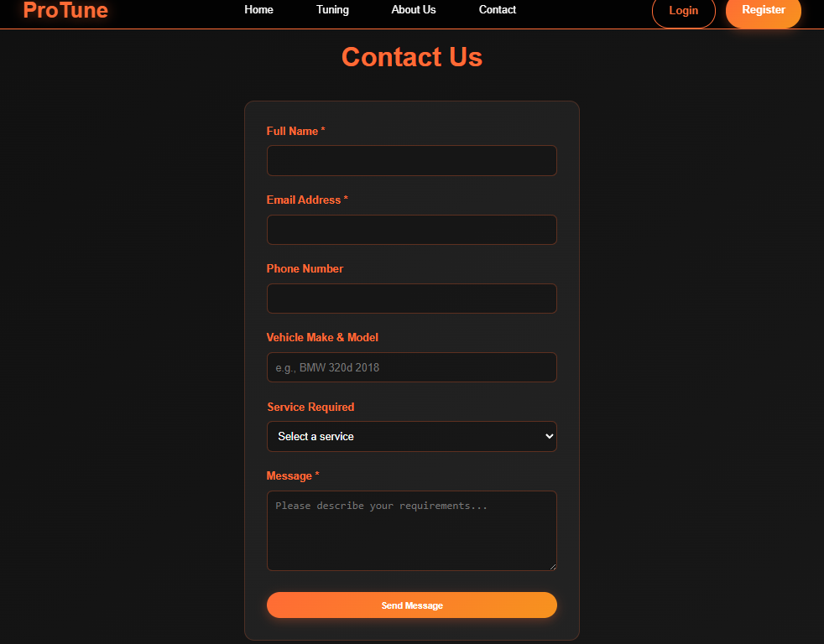

Slide 12
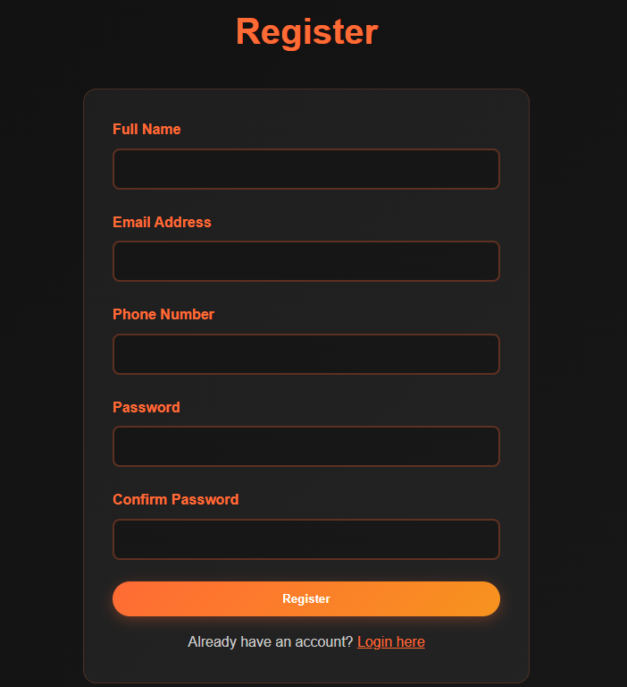
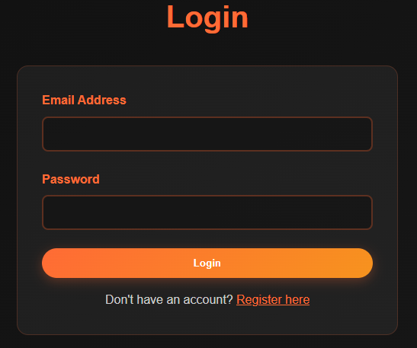
Key features
User authentification – through the use of Login.php and Register.php

Slide 13
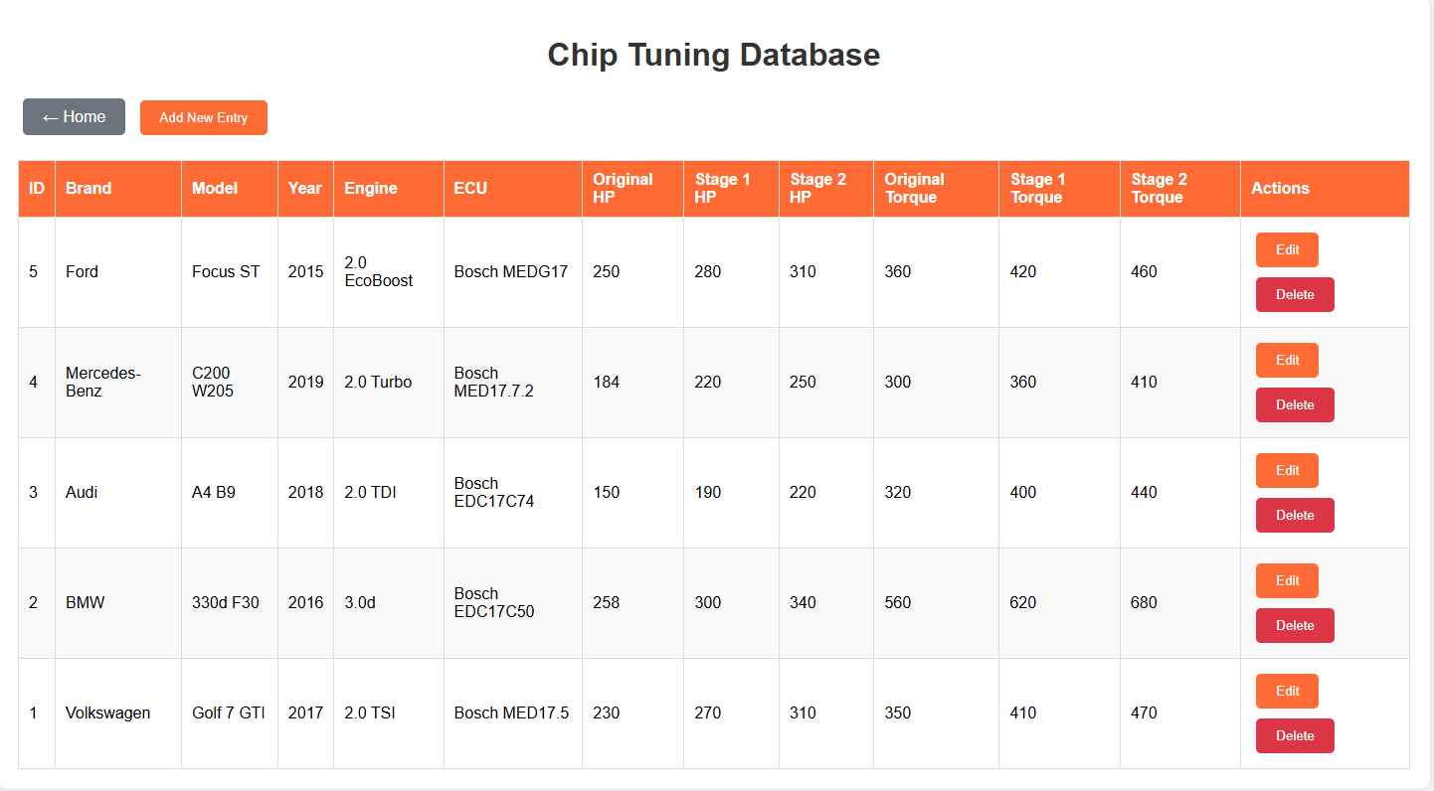


Key features
Admin panel

Slide 14
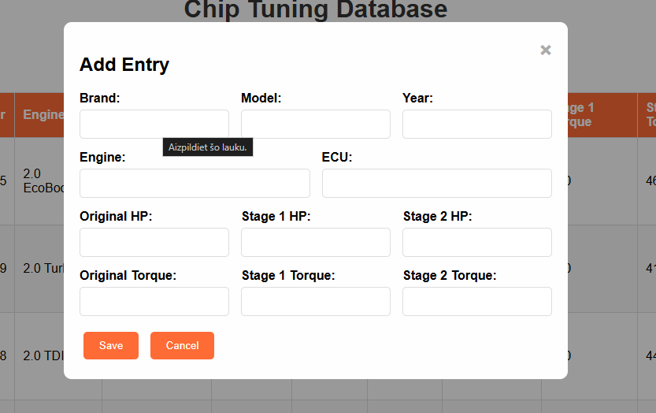


Key features
Admin panel

Slide 15
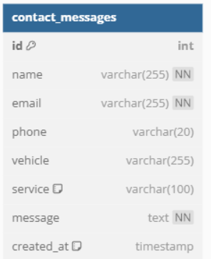
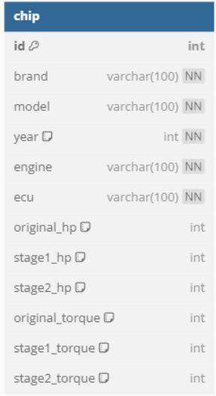
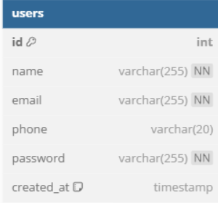
Key features
Database is setup through database_setup.php

Slide 16
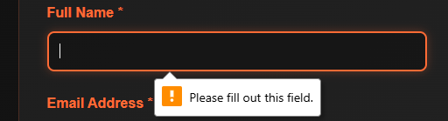
Security Considerations
Session checking in check_session.php
Login/Logout logic
Input validation

Slide 17
Potential improvements
Improve tuner with more accuracy
Add a database with more data (more cars etc)

Slide 18
Conclusion
All in all, the ProTune Chiptuning Website project was a success.
The primary objectives were met, including:
Designing and developing a responsive, user-friendly website
Implementing core features like user authentication, chip data access, and a contact form
Creating a basic admin backend for site management
Ensuring a clean and professional visual design aligned with the automotive theme

Slide 19
Thank you for your attention

